Slide 1

Hand sign detection
Anmol Agarwal (ra2011026010034)
Anurag malik (ra2011026010030)
Jaiaditya ghorpade (ra2011026010035)

Slide 2
Problem statement
Accurate Hand Sign Recognition: The project aims to develop a system that can accurately detect and recognize different hand signs, such as sign language gestures or other hand gestures, with a high level of accuracy.
Real-Time Processing: The system needs to process hand signs in real-time or near real-time to enable seamless communication or interaction between humans and machines without any delays or lags.
Variability and Flexibility: The system should be able to handle variations in hand sign shapes, sizes, orientations, and context, and adapt to different hand sign variations effectively.
Robustness to Environmental Factors: The system should be robust to environmental factors such as changes in lighting conditions, background clutter, or occlusions, to ensure accurate hand sign detection in different real-world scenarios.
User-Friendly and Accessible: The system should be user-friendly and accessible, catering to the diverse needs of different users, including those with disabilities, and should be scalable and cost-effective for wider adoption.

Slide 3
Literature review
Study | Model | Description
[1] | Convolutional Neural Networks (CNN) | Proposed a CNN-based hand sign detection system using RGB images. Achieved high accuracy by training the CNN on a large dataset of hand sign images.
[2] | Support Vector Machines (SVM) | Utilized SVM for hand sign detection with feature extraction techniques such as Histogram of Oriented Gradients (HOG). Achieved good accuracy on a dataset of American Sign Language (ASL) signs.
[3] | Recurrent Neural Networks (RNN) | Proposed an RNN-based approach for dynamic hand gesture recognition using depth data from a depth sensor. Achieved real-time hand sign detection by capturing temporal dependencies in hand movements.
[4] | Deep Learning with Long Short-Term Memory (LSTM) | Developed a hand sign detection system using LSTM networks for sign language recognition. Captured sequential information in hand gestures using LSTM to achieve high accuracy.
[5] | Haar-like features with Cascade Classifier | Implemented Haar-like features and trained a cascade classifier for hand sign detection in real-time. Achieved fast detection and recognition of hand signs with low computational overhead.

Slide 4

Limitations
Limited availability of annotated hand sign datasets for training deep learning models, which can affect accuracy and generalization .
Variability in hand sign shapes, sizes, and orientations, making it challenging to design a robust detection system that can accurately detect and recognize different hand sign variations .
Environmental factors such as changes in lighting conditions, background clutter, or occlusions, which can impact the accuracy and reliability of the detection system .
Real-time processing constraints, as achieving real-time or near real-time processing for hand sign detection may pose computational and latency constraints .
User-dependent variability, as hand sign detection systems may need to adapt to individual users' hand shapes, sizes, and sign language preferences, adding complexity and variability to the system .

Slide 5

objectives
Accurate, real-time detection of hand signs
Robustness to environmental factors and hand sign variations
Adaptability to different users, hand shapes, and sign languages
User-friendly interface and privacy/security considerations
Scalability and cost-effective implementation

Slide 6

Proposed methodology
Data collection and preprocessing
Model selection and training
Model optimization and evaluation
Deployment and testing
Iterative improvement and documentation

Slide 7

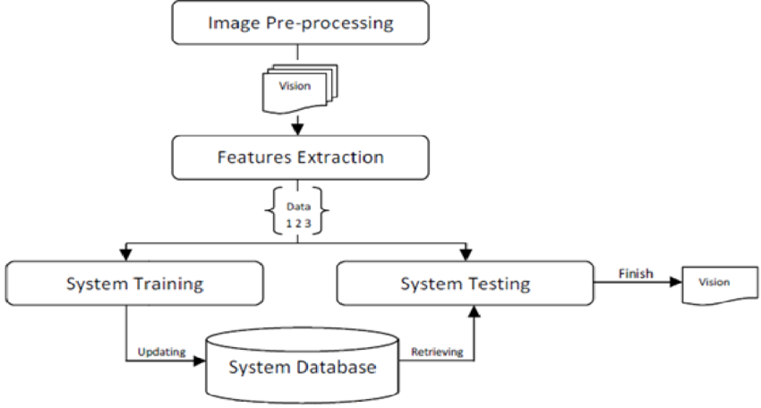
Architecture Diagram

Slide 8
Module description
Data Acquisition: Collecting hand sign data for training and testing.
Preprocessing: Resizing, normalization, and augmentation of data.
Feature Extraction: Extracting relevant features from the data.
Model Training: Training the hand sign detection model using machine learning or deep learning techniques.
Model Optimization: Fine-tuning the model's hyperparameters, architecture, and other parameters.
Model Evaluation: Assessing the model's performance using appropriate evaluation metrics.
Deployment and Testing: Deploying the trained model in a real-world environment and conducting thorough testing and validation.

Slide 9
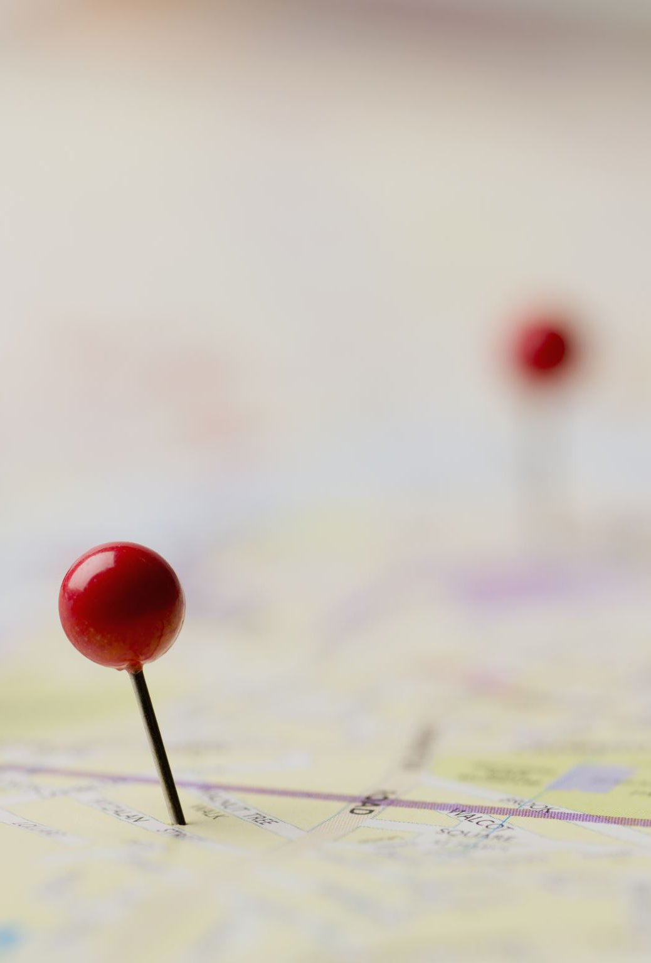
refrences
https://www.wikipedia.org
https://www.researchgate.net/publication/284626785_Hand_Gesture_Recognition_A_Literature_Review
https://www.geeksforgeeks.org

Slide 10

Thank YOu

